Slide 1
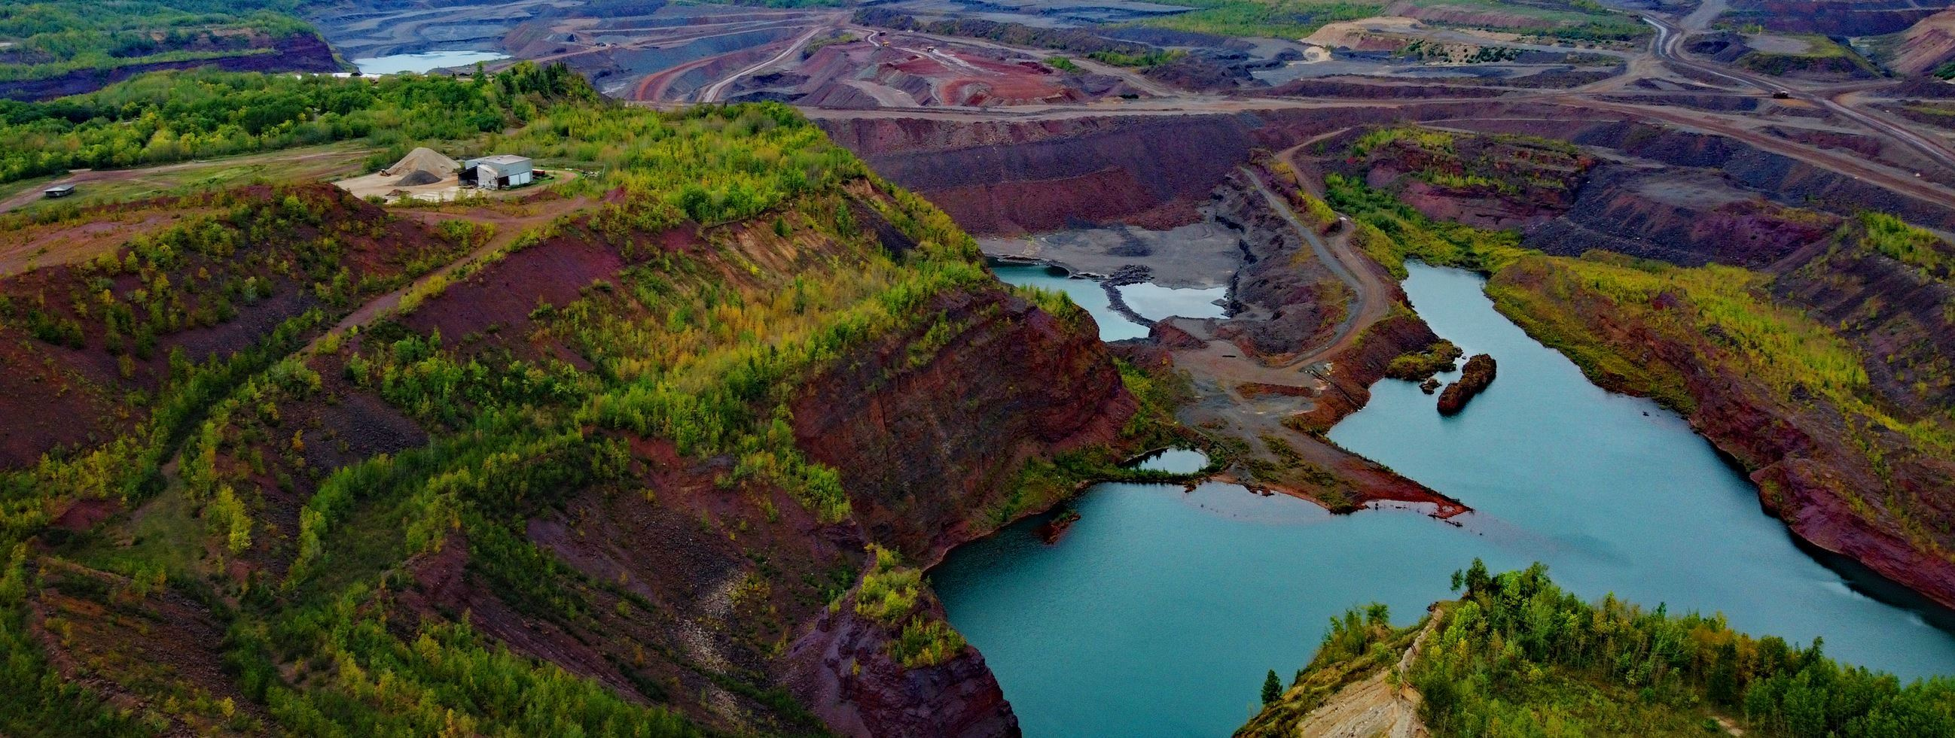
City of Hibbing 2023 Strategic Plan
Develop a Long-Term Direction
Establish Organizational Expectations and Values
Discussion and evaluation of current conditions
Development of a Goals Plan

Slide 2
City of Hibbing 2023 Strategic Plan
Mission Statement
Improve the quality of life for all residents through the delivery of quality and sustainable services.
Vision
A thriving community that leverages resources, opportunities, and strengths to enhance quality of life!

Slide 3
Core Values
Leadership: identifying issues and developing solutions.
Excellence: providing valuable and accurate information.
Trust: earning and maintaining the trust of our citizens.
Innovation: applying creative ideas to solve city problems.
Collaboration: developing a network that adds value to the organization.
Stewardship: taxing and spending in a responsible manner.
Transparency: including our taxpayers in the process.
Professionalism: hiring, training, and recognizing exceptional staff.
Accountability: reporting to our residents.

Slide 4
2023 Strategic Plan Long-Term Strategies
Thriving Destination and Regional Leader
Enhancing local tourism and growing as a travel destination
Partnering and promoting strengths with other regional communities
Building off regional airport and outdoor assets
Bolster and maintain transportation connections
Leading model of City operations, governance

Slide 5
2023 Strategic Plan Long-Term Strategies
Well-rounded, Strong Quality of Life
Quality housing stock that is affordable and accessible
Strong schools and educational systems that draw people to the City
Modern facilities for recreation and wellness making the City a healthy place families want to live
Youth-oriented programming and services, particularly around the outdoors
Access to quality medical care and facilities in the City
Comprehensive services for all phases of life

Slide 6
2023 Strategic Plan Long-Term Strategies
Engaged and Forward-Thinking Leadership
Transparent and collaborative local government
Representative of the community
Future-focused on all levels of the organization
Community-oriented problem solving
Sustainable operations
Destination careers that attract and retain high-quality employees

Slide 7
2023 Strategic Plan Long-Term Strategies
Vibrant Economic Hub
Destination for shopping and dining
Diverse types of industry providing local jobs
Economic growth to draw and retain people
Examine fiscal impact of changes/termination in mining

Slide 8
2023 Strategic Plan Long-Term Strategies
Safe, Secure, and Valued Community
Everyone feels they are an integral and involved part of the community
Services and infrastructure for young and older generations
Safe place to live and raise a family
Lead in concert with private, public, and non-profit partners to sustain community
Celebration of diverse ethnicities and pride in community heritage

Slide 9
2023 Strategic Plan Long-Term Strategies
Excellence in Delivery of Services
Well-maintained and high functioning infrastructure
Technologically advanced, effective processes
Engaged employees making a positive impact
Progressive approach in partnerships and networking with local, state, and federal entities
Integrity and trust throughout organization
Fiscally responsible and efficient
Accountability to community and each other

Slide 10
Thriving Destination and Regional Leader
Well-rounded, Strong Quality of Life
Vibrant Economic Hub
Safe, Secure, and Valued Community
CORE STRATEGIES
Engaged and Forward-Thinking Leadership
Excellence in the Delivery of Services

Slide 11
2023 Strategic Plan Organizational Expectations
City Council
Expectations
Integrity
Be objective
Respect
Feel valued
Trust
Open communication
Provide a unique perspective
Be educated and prepared for meetings
Be relevant
Get all the information
Focused
Cooperative
Bring different views but share common goals
Be transparent
Leadership Team/Staff
Expectations
Communication
Respect
Trust
Honesty
Patience
Be adaptable
Passion
Be sensitive
Be genuine
Empathy
Be considerate
Professionalism
Be accountable
Be supportive
Have fun with the experience

Slide 12
2023 Strategic Plan Organizational Expectations
City Council Perspective:
Expectations of Staff
Trust
Truth
Lead with confidence and competence
Respect
Dedication
Professionalism
Know and respect roles
Don’t be afraid to ask questions, ask for help
Be coachable/trainable
Treat residents with respect
Be ambitious
Feel valued
Possess high interpersonal communication skills
Be advocates for the City
Leadership
Provide accurate information
Be good listeners
Treat employees with respect, human-to-human
Be knowledgeable
Pride top-to-bottom
Leadership Team/Staff Perspective:
Expectations of City Council
Support
Loyalty
Trust
Participation
Priority/vision
Parameters
Boundaries
Cohesive vision
Knowledge
Communication
Patience
Willingness to take the journey
Open mind
Transparency
Candor
Professionalism
Positivity
Creativity

Slide 13
2023 Strategic Plan Organizational Expectations
City Council Perspective:
Provides for Staff
Training opportunities
Lead by example
Fair budget
Good wages/benefits
Freedom to operate
Tools to succeed
Don’t set up for failure
Help unlock potential
Positive leadership
Safe, healthy workplace
Political leverage
Transparency, whole story
Understanding
Listening ear
Insight into resident/community feedback
Trust/Truth
Leadership Team/Staff Perspective:
Provides for the City Council
Data/Information
Knowledge
Communication
Recommendations
Execution of vision
Feedback
Navigation of political landscape
Respect
Support
Access
Expertise
Efficiency
Fiscal responsibility
Performance metrics
Follow-through
Willingness to go on the journey
Transparency
Open-mindedness

Slide 14
2023 Strategic Plan Primary Goals
Completion of 3 big projects; mineview, campground, Public Safety building (bigger than projects, include areas)
Implement a plan and program to revitalize Howard Street
Complete feasibility study on community recreation center
Create CIP for City Equipment, Facilities and Infrastructure
Acquiring more property (building our land portfolio) for Economic Development
Clean-up ordinances leading to greater enforceability

Slide 15
2023 Strategic Plan Opportunity Goals
Breaking ground on the Hills, residential development plan (Fall 2024)
Update Comprehensive Plan
High-Speed internet for all
Increase Youth/all ages activities
Find and implement detox facility project
Implement and update organizational policies and procedures
Develop/Streamline process to deal with privately-owned blighted/dilapidated/vacant buildings, housing, and junk on property
Automate/leverage technology to deliver services and optimize workflow

Slide 16
2023 Strategic Plan Implementation
Linking Long-Term Direction to Short-Term Action Plans
Develop Action Plans - measurable, action steps, dedicate resources to achieve
Keep consistency and focus in uncertain times
Communication within organization and community
Implement and monitor progress

Slide 17
Key Results Areas
Long Term Financial Sustainability
Economic Vitality
Community Growth and Public Safety
Communication and City Image
Community Pride and philanthropy

